Slide 1
Recording your work
How using a digital based solution can ensure you can explain the decisions you make
Presented by Andrew Ross

Slide 2
Being audited and using an electronic system
In August 2019 the Building Professionals Board conducted a major state-wide audit
The main catalyst for the audit was highly publicised issues with safety, both locally and internationally, and a public outcry for more thorough and transparent accountability across the board in construction
Most private certifiers across NSW were compelled to provide the previous two years of their Part 4A certificate register
A percentage of that group also had to provide everything related class 2 buildings they had certified from August 2017
Under section 106 (3) of the Building and Development Certifiers Act, the Secretary may conduct an audit of a registered certifier or an accreditation authority at any time
EDAP Western Group Conference 18/05/23

Slide 3
As a provider, what we realised
It became evident how difficult record keeping can be with information either stored as a “hard copy” or across multiple storage mediums
It also quickly became apparent that digital solutions allowed certifiers accurately supply the information in a matter of minutes
Companies, in some circumstances, needed to temporarily employ additional staff to collate years of data into the format requested by the BPB
In some rare cases the information couldn’t be supplied resulting in penalties for the certifier and/or their company
EDAP Western Group Conference 18/05/23

Slide 4
What is a digital based solution and why should anyone use one?
In simple terms, it’s a paperless system where all project related data is stored electronically
Some companies have created their own using Access and Excel style databases but recent data shows the overwhelming majority of NSW certifiers use purpose built certification software
In the past local servers could provide storage but in the age of “working from home/anywhere” cloud based storage is becoming the new standard
The latest technology allows teams to collaborate and access work without the need to be in the same office, or even the same state
Most importantly it allows an accurate history to be delivered throughout the life of a project as well as decades into the future
EDAP Western Group Conference 18/05/23

Slide 5
What is a digital based solution and why should anyone use one?
One of the biggest issues certifiers face is liability, both while accredited and the years to follow. How do they retain all this information and access it when required?
Two major areas of risk are the decision to issue an approval and the overall result of each mandatory critical stage inspection. These are the two areas I’ll be focusing on today
EDAP Western Group Conference 18/05/23

Slide 6
Approvals: How to show your reasons
In the vast majority of approvals issued everything goes as planned. However in the case it doesn’t how can you provide a clear explanation of why and how you provided your CC, CDC or OC?
If a certifier is audited, being on the front foot to provide dates, revisions and comments/notes made along the way within the usually fairly tight timeframes can be the key to avoiding any penalties
Reports, whether statutory or not, will need to be provided. Having the information is great but it needs to be delivered in an easily read format
EDAP Western Group Conference 18/05/23

Slide 7
Using an online checklist
Rather than sending a static document from an email back and forth that needs to be manually edited using an online checklist allows real time updates
If you have multiple revisions that history is stored, received dates are recorded
EDAP Western Group Conference 18/05/23

Slide 8
Using an online checklist
Most systems will allow checklist items to be filtered. For example by the LGA or the building classification
Most importantly the data is actual data, not text in an email or on a word document
All the comments you’ve made along the way are recorded that can outline the justification and reasoning for your decision
EDAP Western Group Conference 18/05/23

Slide 9
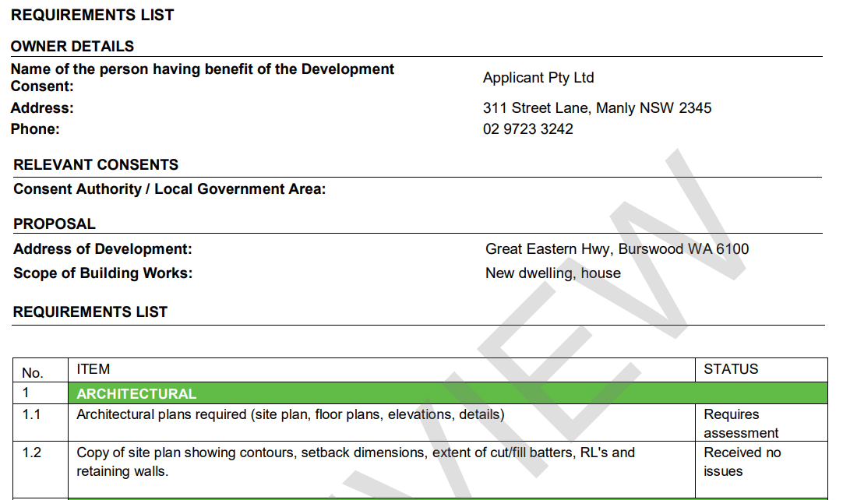
Using an online checklist
By having raw data we can accurately send initial request for information documents and follow ups
EDAP Western Group Conference 18/05/23

Slide 10
Completing Inspections
All mandatory critical stage inspections need to be reported to the Department of Fair Trading within two days of completion
A statutory register of completed inspections should also be kept
Whilst you may not include all photos or notes in a report you are going to want to keep them as a reference down the track
A standard inspection report will generally only include unsatisfactory items but you may be requested later on to show further evidence of checklist items you deemed satisfactory
EDAP Western Group Conference 18/05/23

Slide 11
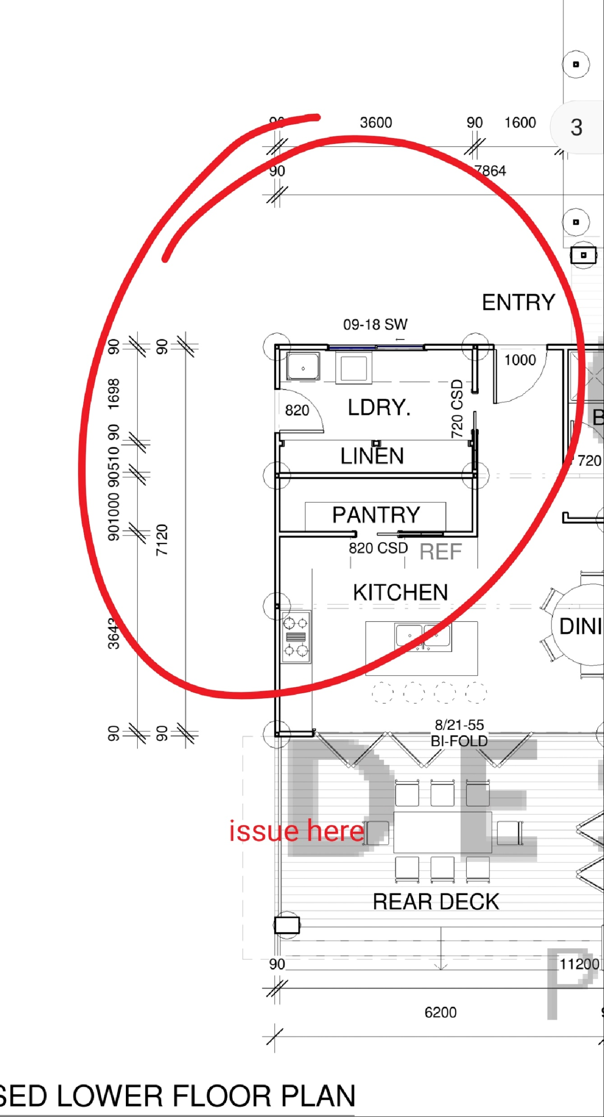
Using a mobile inspection app
Unlike paper based systems all of your approved plans and project documentation is on one device in your pocket
Photos and screenshots of areas of your plans can be marked up on the go
EDAP Western Group Conference 18/05/23

Slide 12
Using a mobile inspection app
Pre-defined responses can be configured to speed up the process and create confidence and consistency in your reports
Most apps will allow voice to text
Some apps will allow you to generate a report directly from the device
You can report your result to NSW Fair Trading automatically and immediately
EDAP Western Group Conference 18/05/23

Slide 13
Using a mobile inspection app
Defects can be recorded in an open defect register. You can focus on the issues on the re-inspection and not worry about the issues previously deemed satisfactory
By having an app that integrates with a document management system you can close off defects raised on the app, even in the case a re-inspection is not required
Once again, you are recording data. This data can be used to create multiple inspection reports, overall reports and be pushed through an API when required (planning portal)
EDAP Western Group Conference 18/05/23

Slide 14
Using a mobile inspection app
Whilst we’ve focused generally today on the using the app for building certification inspections providers today are offering it to be used in other areas of compliance as well
EDAP Western Group Conference 18/05/23

Slide 15
Questions?

