Slide 1

DCS Spatial Services
Data, products and digital twins
Adrian White
  Director Spatial Operations
  Spatial Services
24 February 2023

Slide 2
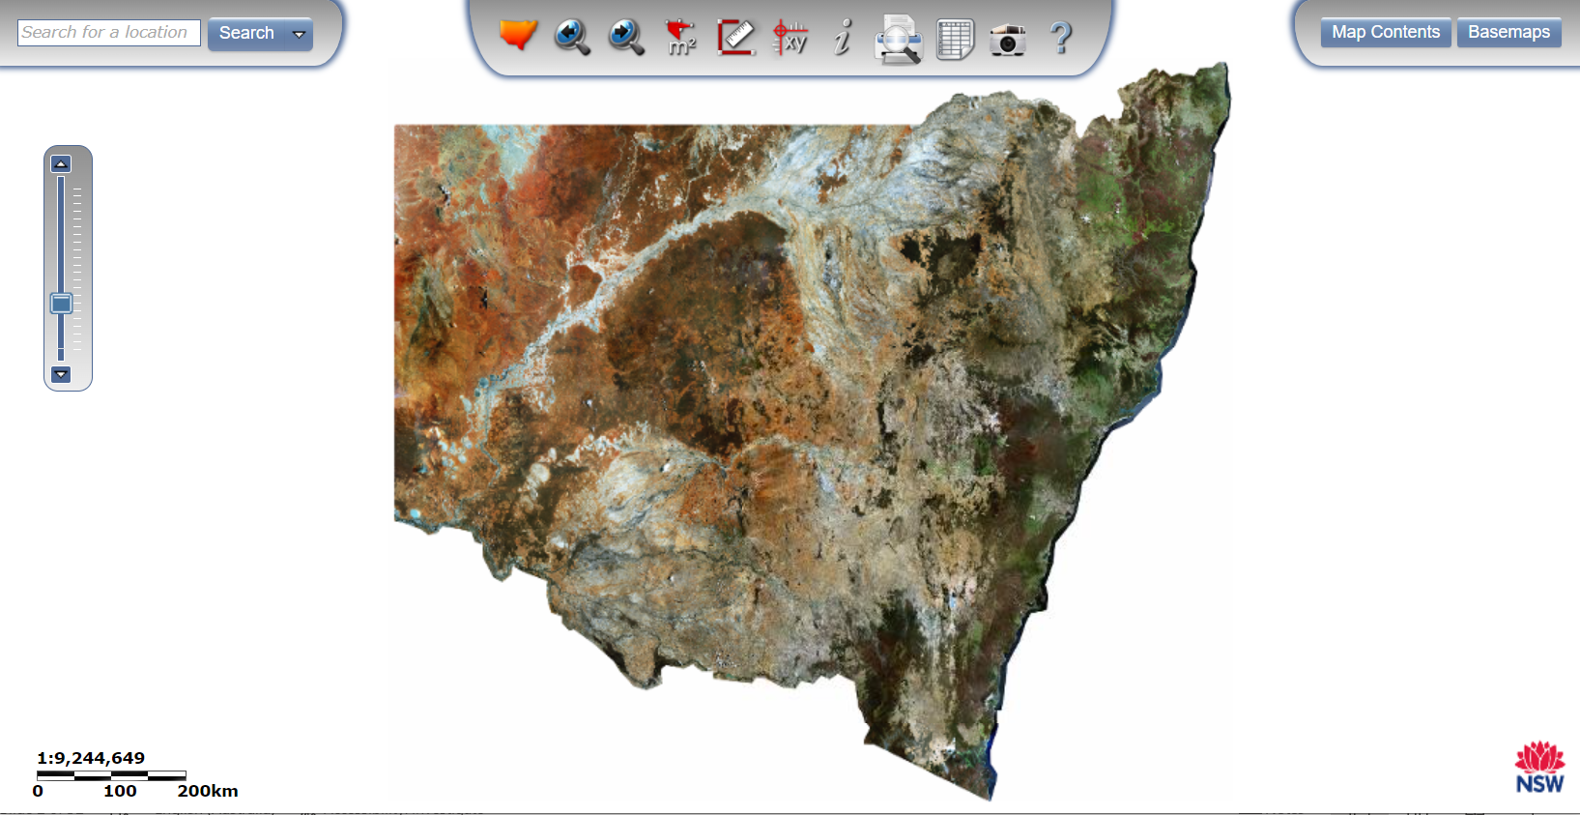

Slide 3
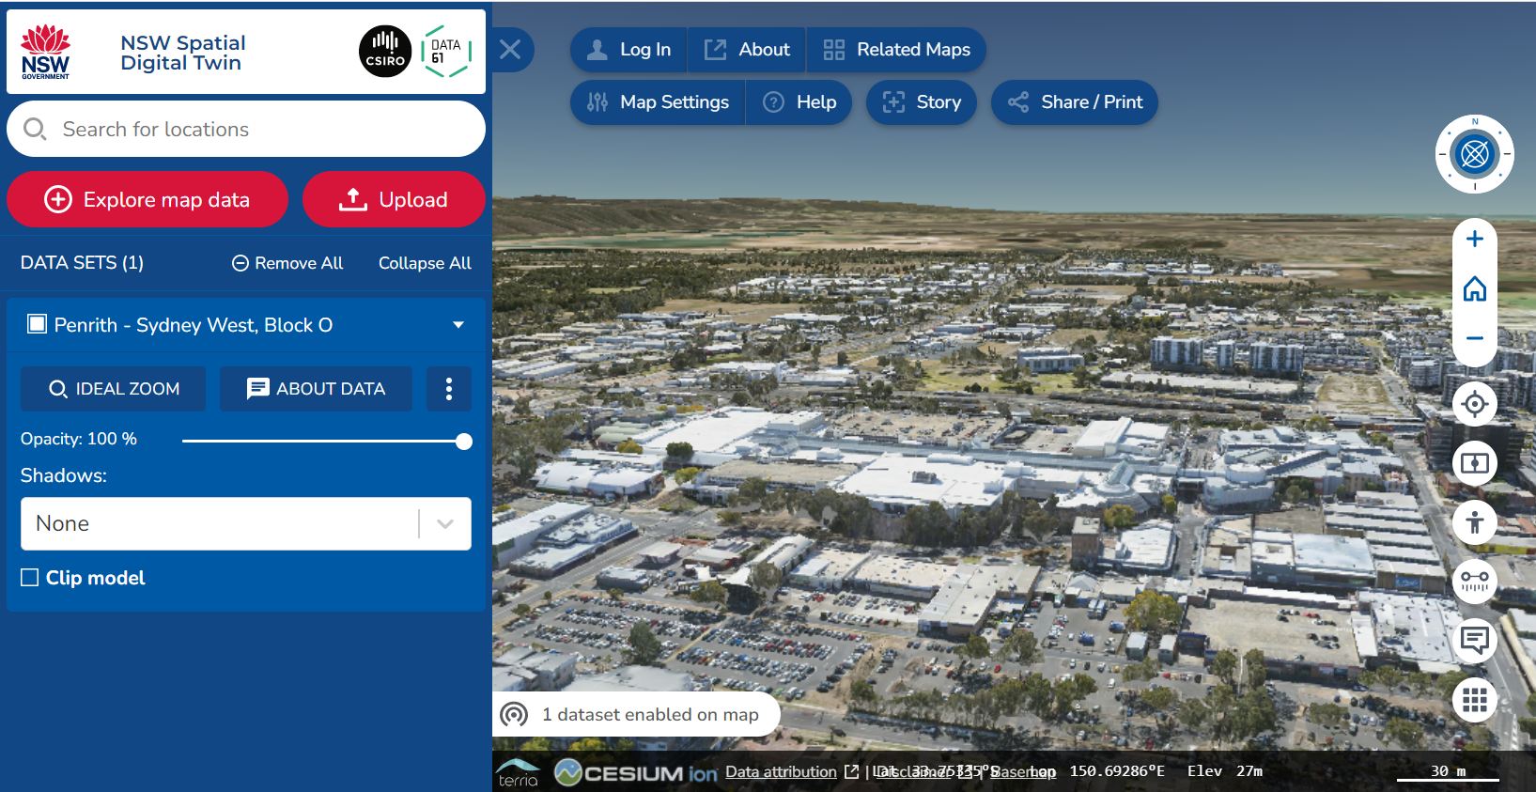

Slide 4
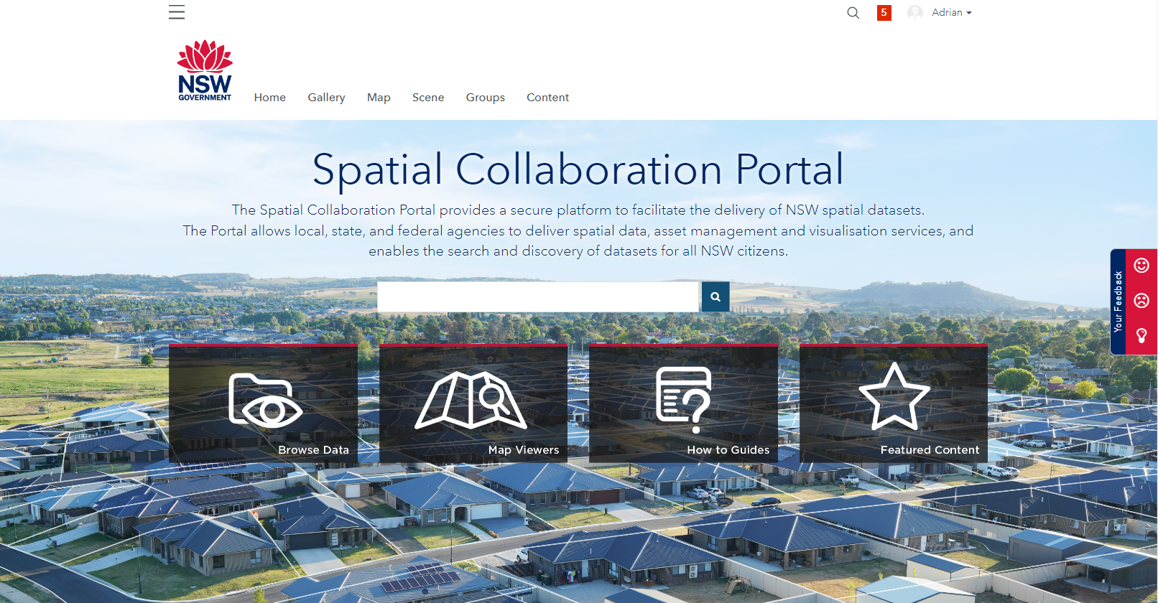
portal.spatial.nsw.gov.au

Slide 5
DCS Spatial Services
Department of Customer Service – Digital.NSW
PMO
Spatial Services
Exec & Business Operations
Office of the Surveyor-General
Spatial Operations
ICT
Customer & Emergency Management Services
Live NSW
Survey Operations
Cadastral
Information Services
Emergency Information Coordination Unit
Geographical Names Board
Environmental
Digital
Services
Infrastructure Data
Board of Surveying & SI
Administrative
Customer Experience
& Insights
Data Sourcing
Data Supply
Data Management
Product/Service Development
Product/Service Delivery
Customer Service

Slide 6
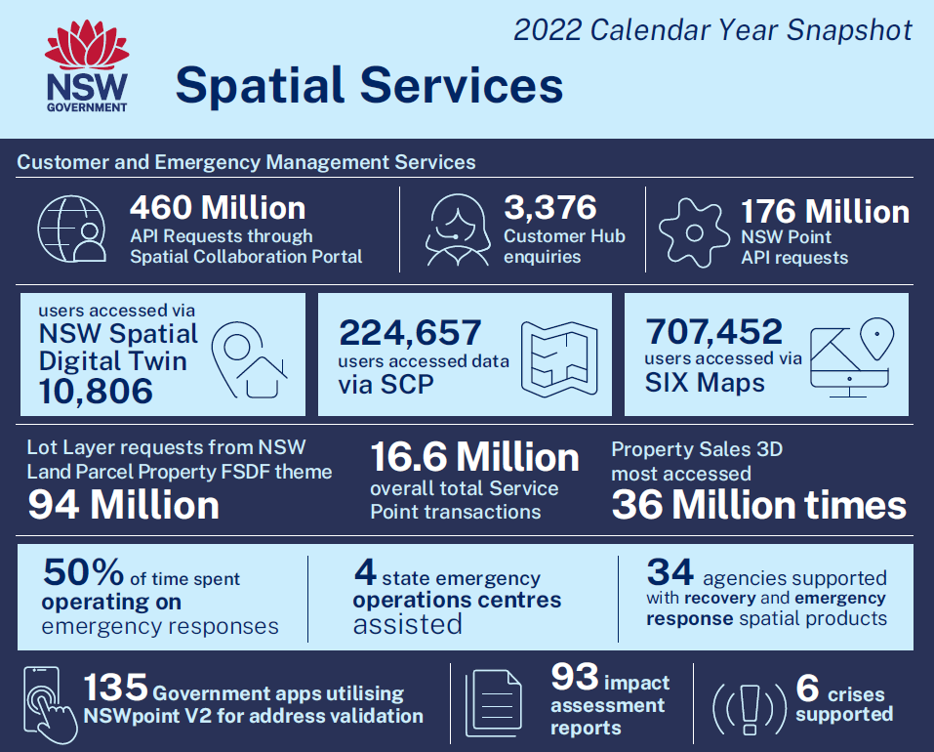

Slide 7
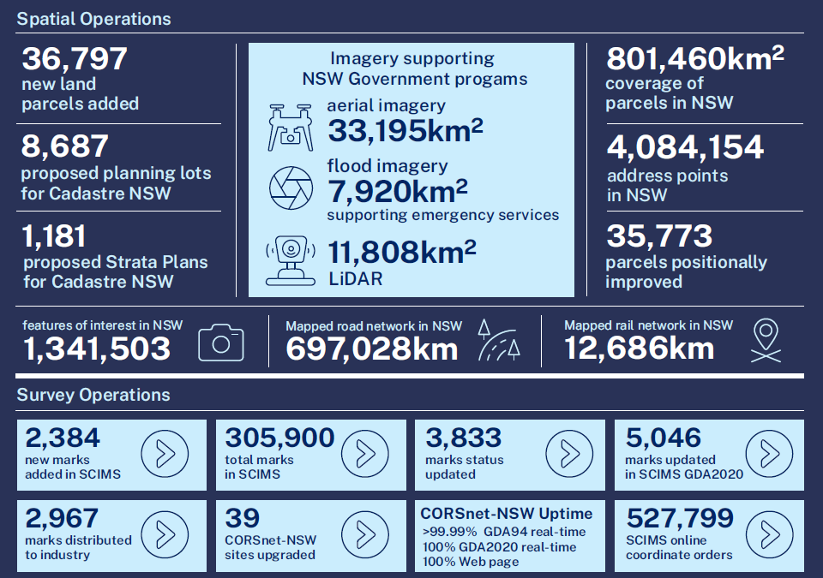

Slide 8
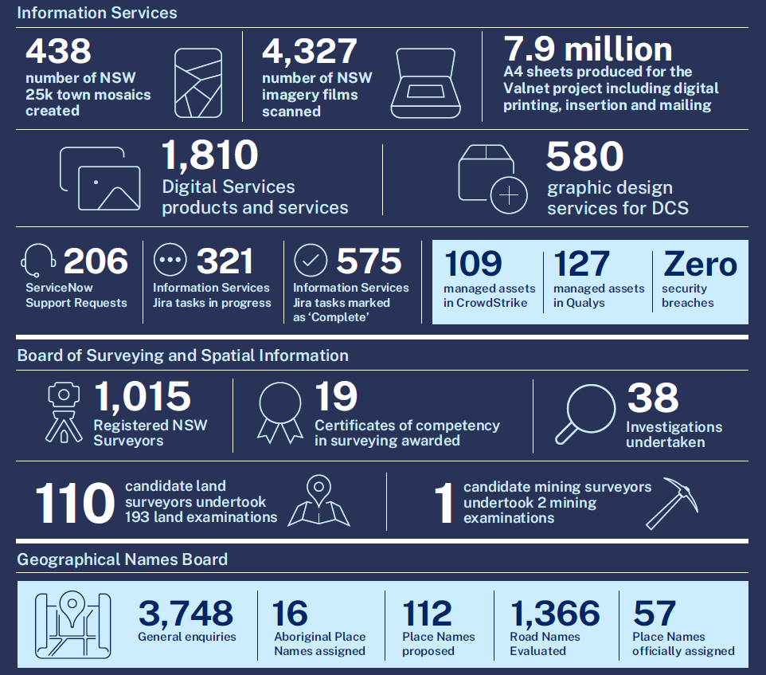

Slide 9
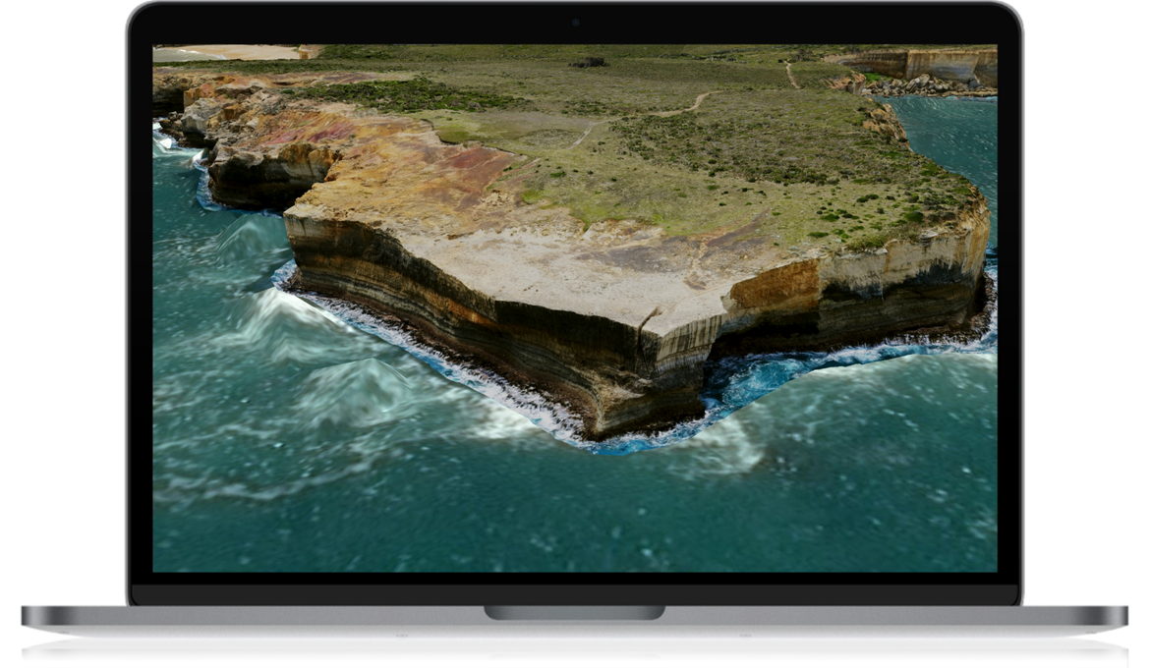
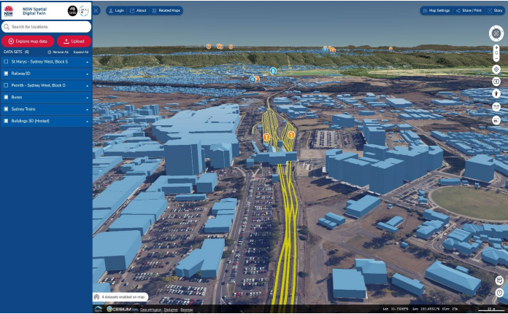
NSW Spatial Digital Twin powered by the Live NSW program
$40m funding from the Digital Restart Fund to deliver
Transformation of foundation spatial data systems and processes
State wide gravity model
Visualisation and customer engagement capabilities
LIVE NSW
Dynamic
one–stop-shop for government spatial data, products and services

Slide 10
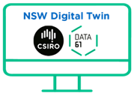
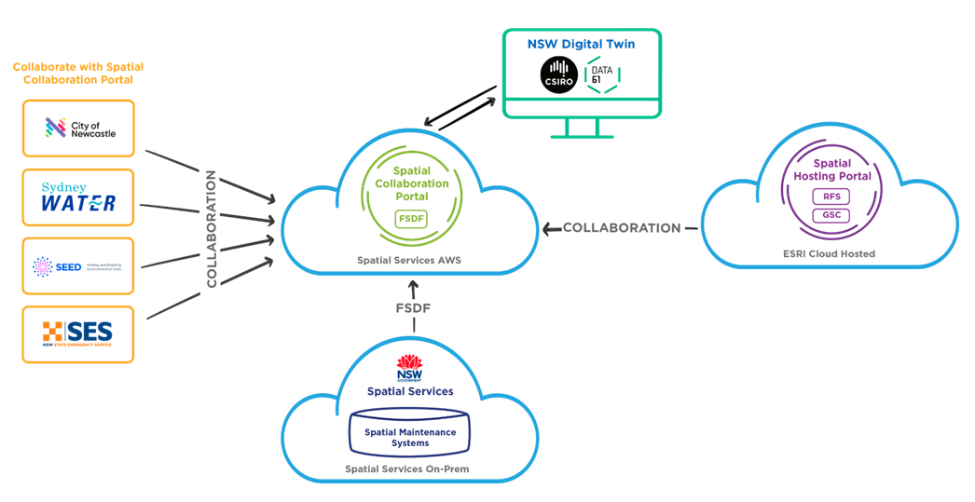

Collaboration and federation of geospatial data
OTHER

Slide 11

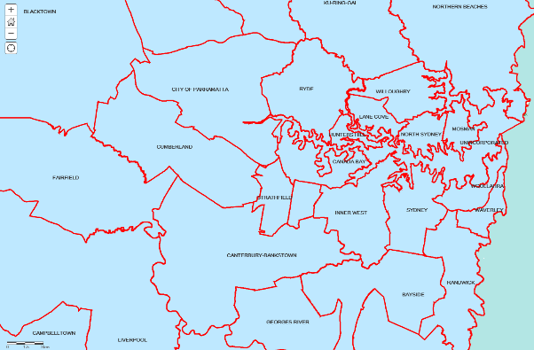
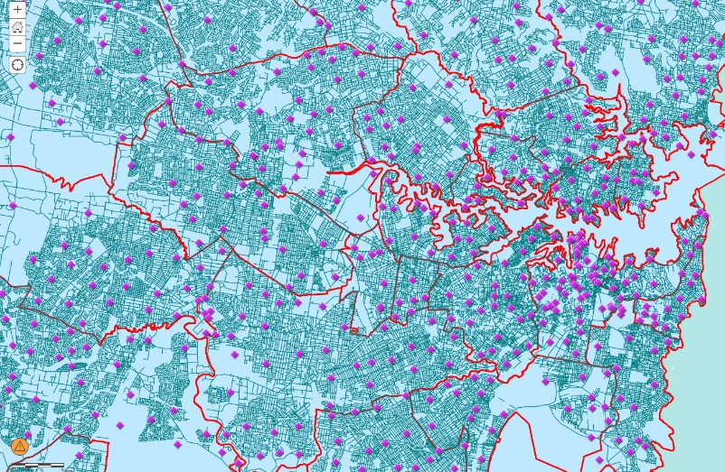
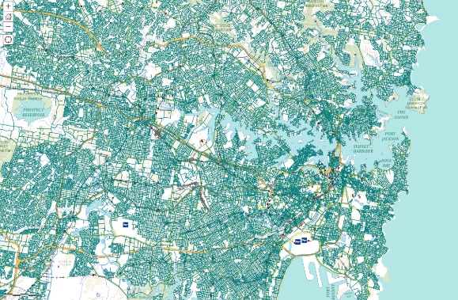
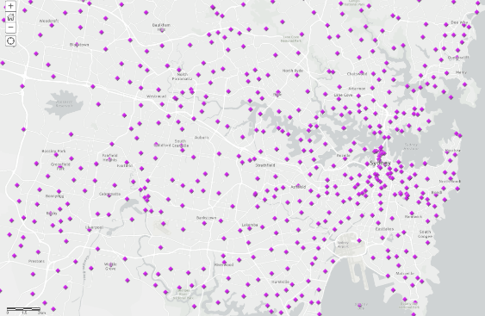
Open, secure & restricted data
Ability to collate multiple data layers
RESTRICTED DATASET
Sensitive data can remain restricted
RESTRICTED DATASET
Make open data layers available for use
NSW ADMINISTRATIVE BOUNDARIES THEME
LOCAL GOVERNMENT AREA
Allows improved agency data collaboration
NSW TRANSPORT THEME
ROAD SEGMENT
NSW FEATURE OF INTEREST CATEGORY
PLACE POINT

Slide 12


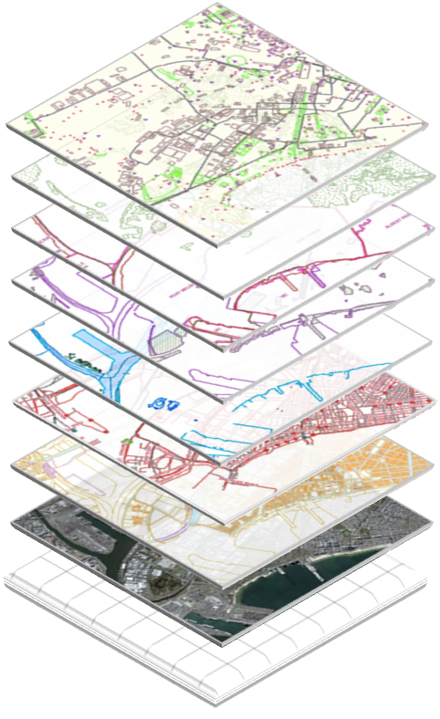










Modernisation of the FSDF
BUILDINGS & SETTLEMENTS *
PHYSICAL INFRASTRUCTURE *
Spatial data underpins all place-based decision making. It’s regarded by the UN as essential for a successful economy, supporting countries to reach their Sustainable Development Goals.
FSDF modernisation = Standards based, 3D/4D, interoperable
GEOLOGY & SOILS *
POPULATION
ELEVATION & DEPTH *
PLACE NAMES *
BOUNDARIES
WATER
ADDRESS *
TRANSPORT *
IMAGERY *
POSITIONING *
LAND PARCEL & PROPERTY *
LAND USE
UN GGIM
New themes; *new strategies or standards underway
Notes:
Modernise FSDF information to increase its accuracy and reliability and adopt 3D and 4D formats (where applicable) to meet emerging user needs - ensuring the FSDF is fit for future purposes.
ANZLIC and ICSM are working to modernise foundation spatial data to 3D and 4D (time) digital formats, this includes:
Streamlining processes to collect and supply spatial data to users across the full data lifecycle: capture, procure, access, standardise, maintain and value-add.
Enabling better data management practices, focusing on governance, privacy and cyber security, discoverability and accessibility.
Driving development and adoption of open spatial data standards that align with and inform international standards.
In addition, the ICSM Metadata Working Group is undertaking a work program that includes data governance, management and metadata and is applicable across all of the FSDF themes.

Slide 13
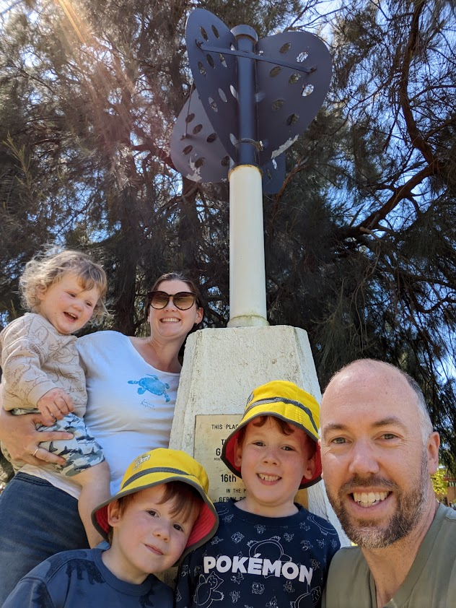
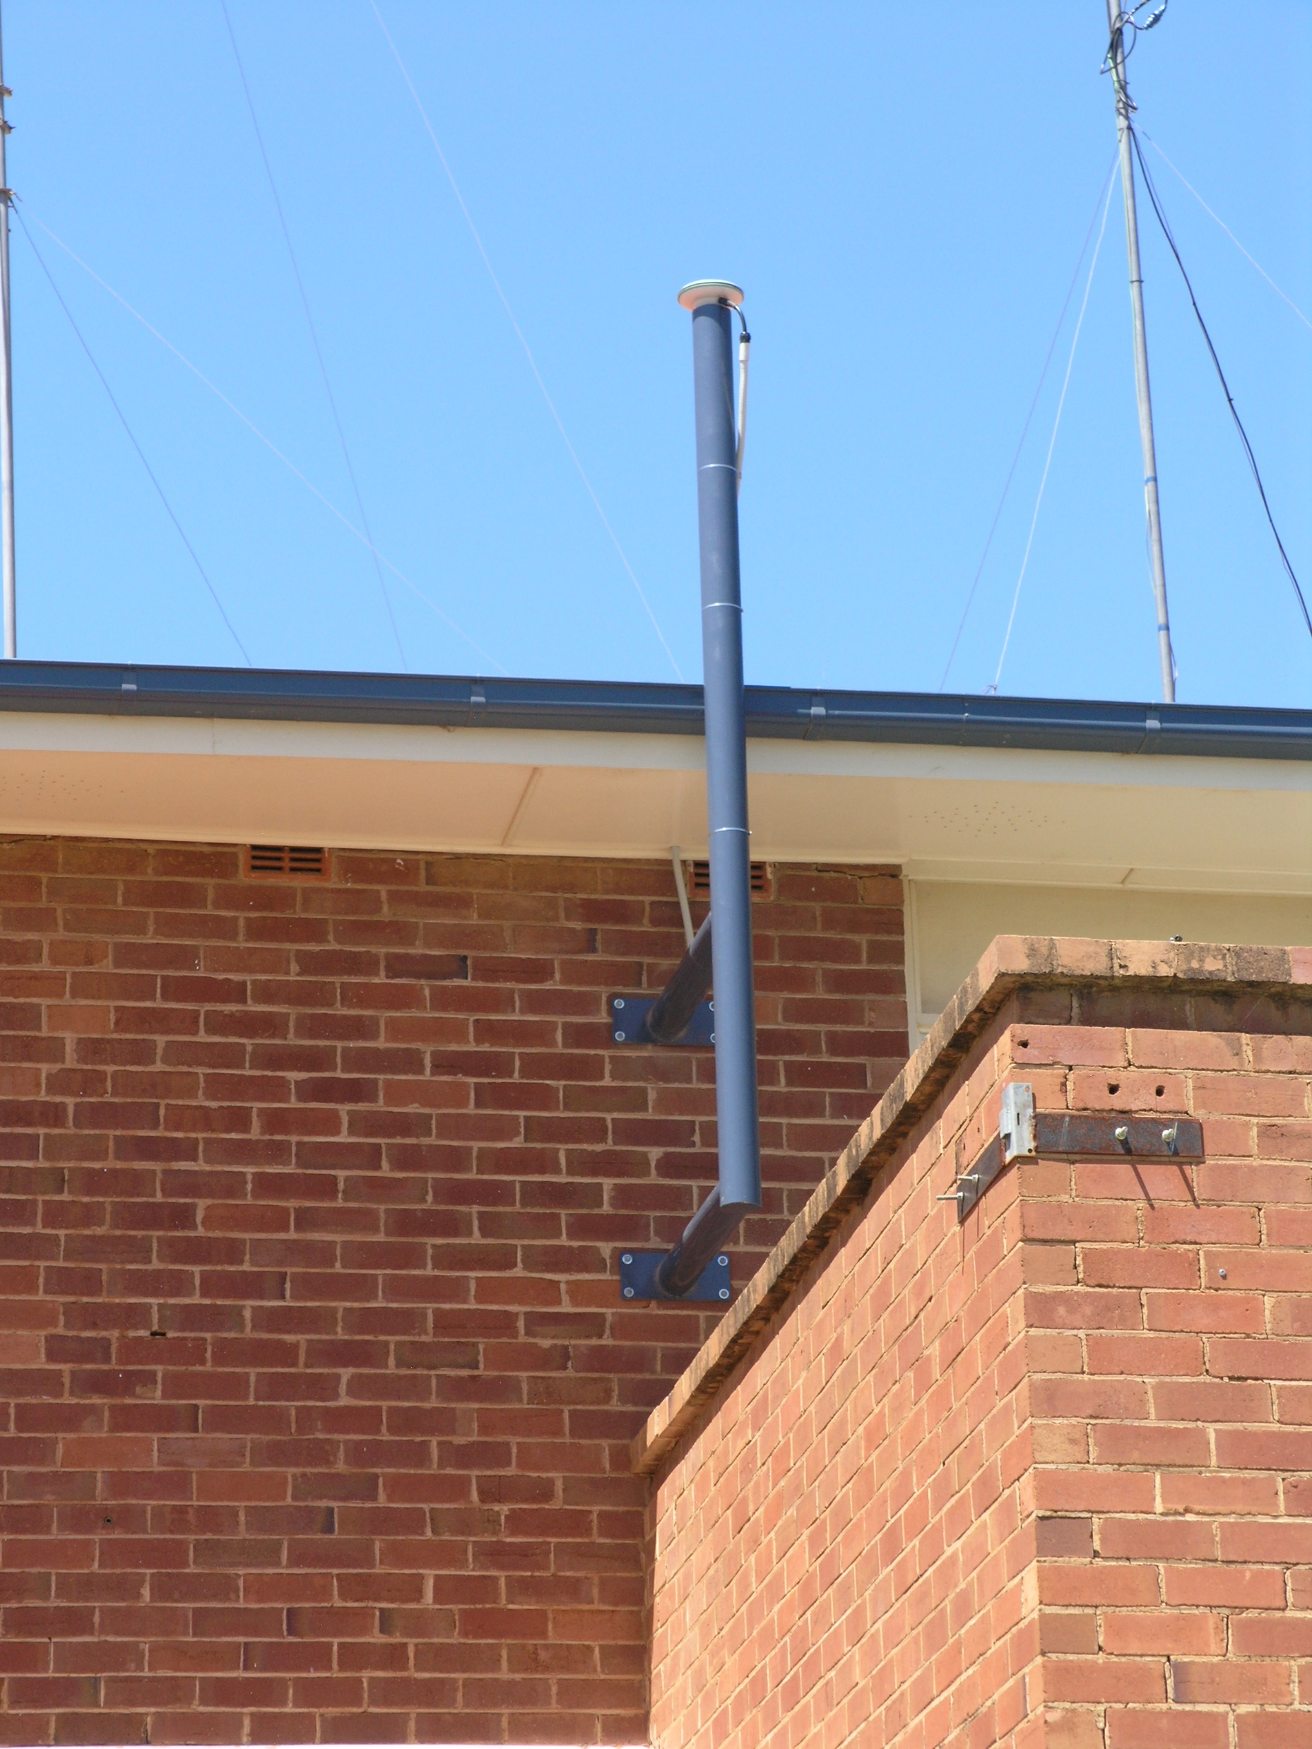

Slide 14
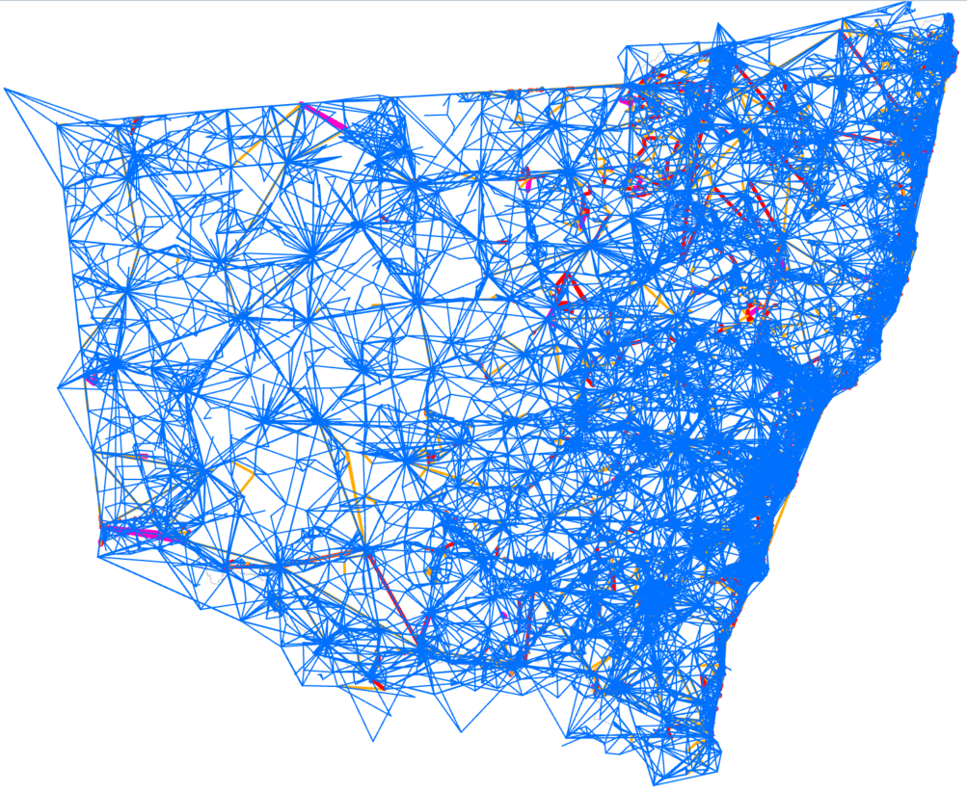
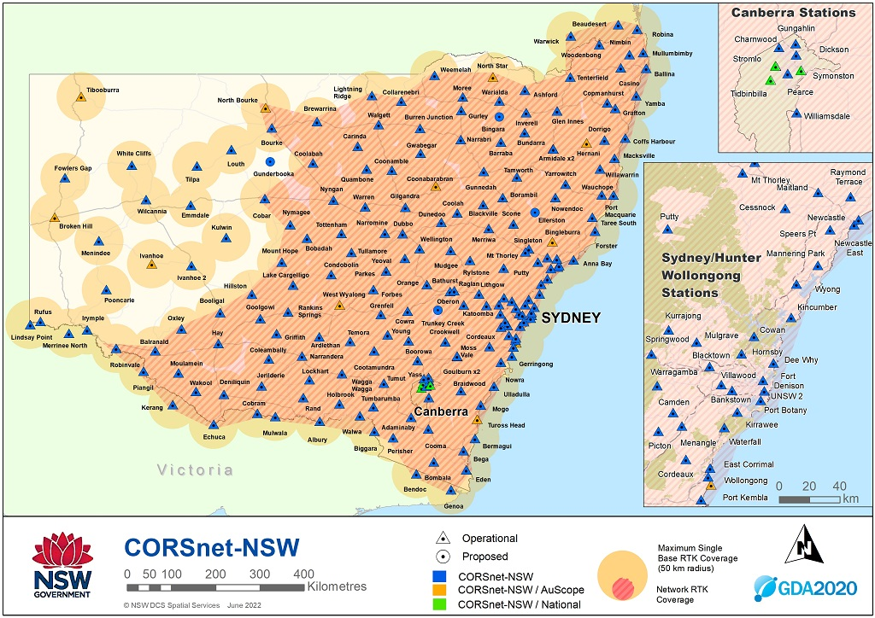
Positioning – State control survey (GDA2020)

Slide 15
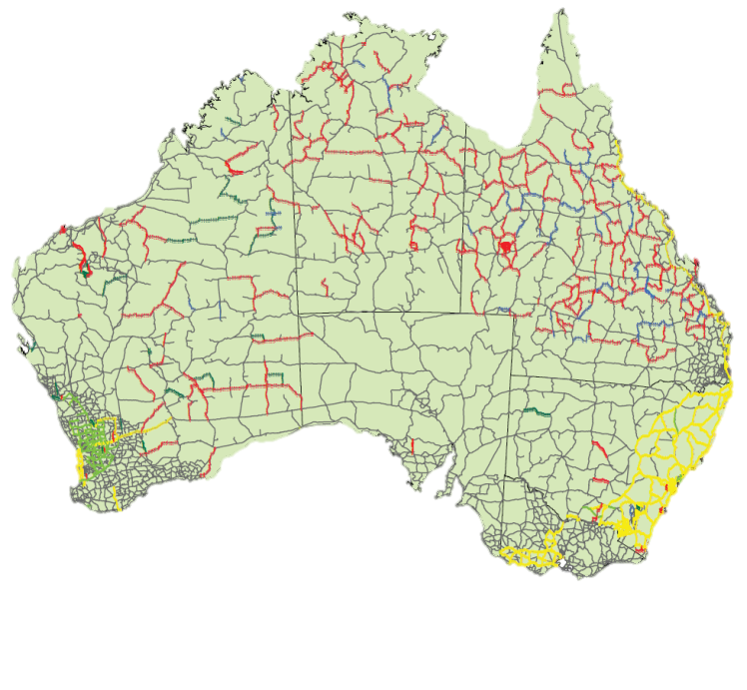
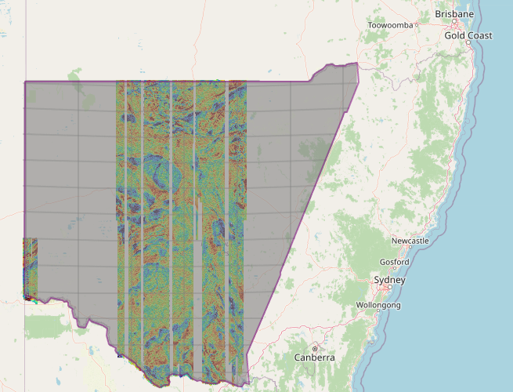

Positioning – height datum
Australian National Levelling Network (AHD) ~180,000km
Gravity Model (AVWS)
Notes:
50% Capture of the whole State completed
Two Suppliers; Xcalibur and SGL completing the capture
Scheduled for completion end of 2023
Gravity data freely available on Minview (GSNSW)
New geoid model will be updated with gravity dataset brining increased height accuracy in NSW

Slide 16
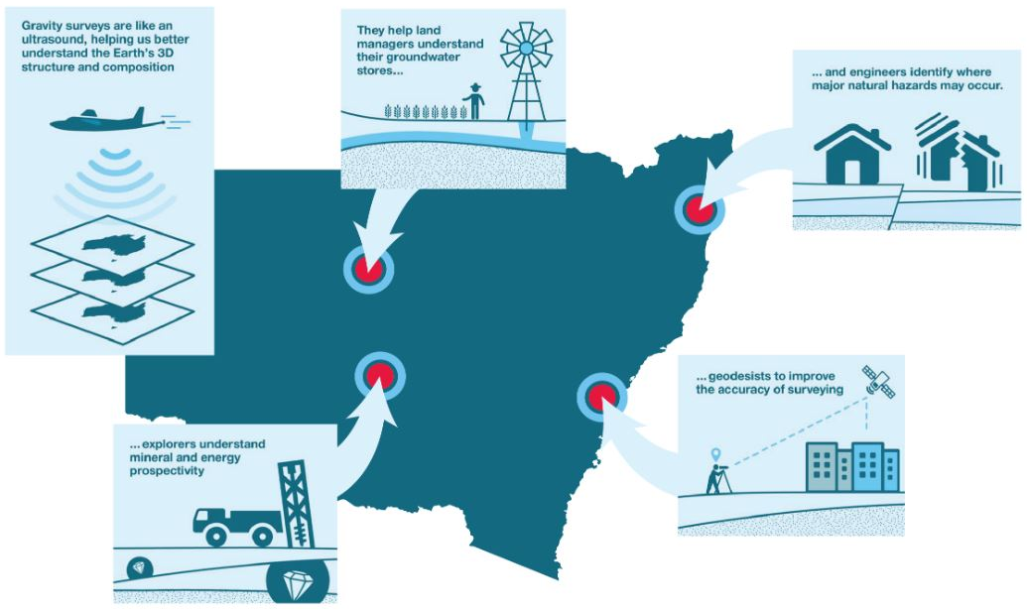
NSW gravity model benefits
Notes:
Improve the State’s gravity dataset (including a significant improvement of resolution of subsurface imaging) to benefit whole-of-government and empower a wide array of industries including:
Future resource investment opportunities, potentially aiding regional jobs and economic growth across NSW
Exploration and management of groundwater stores
Earthquake hazard detection
Inform land use decision making
Allow everyday GNSS users to determine accurate ‘real-world heights’ using modern positioning services that benefit:
Bushfire recovery efforts
Large infrastructure projects
Property, construction, agriculture, mining & surveying,
Flood mapping
Underpins NSW Digital Twin and FSDF
Reduce levelling survey expenditure across all 3 tiers of Government

Slide 17
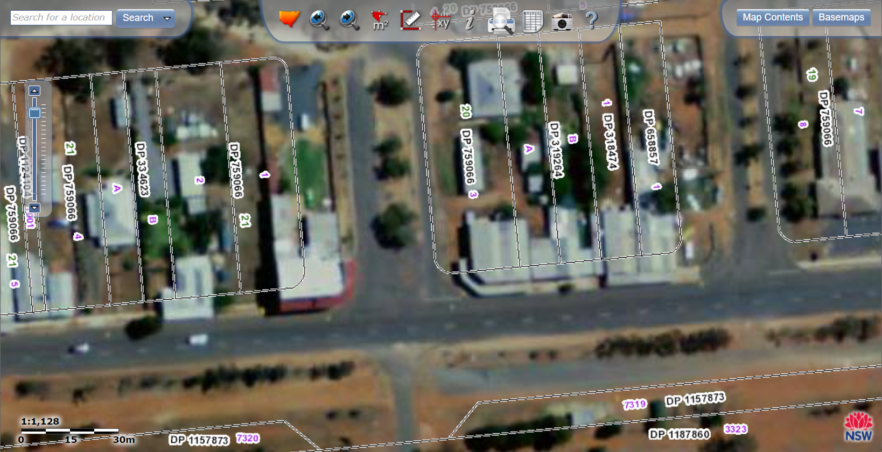
Land Parcel & Property

Slide 18
New Standard for the Accuracy of Spatial Cadastres (DCDB)
% NSW parcels compliant with target accuracies
(indicative figures only)
Urban (metro) |  |  | Urban (other) |  |  | Rural (>5000m²) |  | Remote (Pastoral)
<0.05m | 0.06 - 0.2m | >0.21m | <0.05m | 0.06 - 0.2m | >0.21m | <0.5m | >0.5m | <5m | >5m
15% | 18% | 67% | 17% | 16% | 67% | 23% | 77% | 18% | 82%

Slide 19
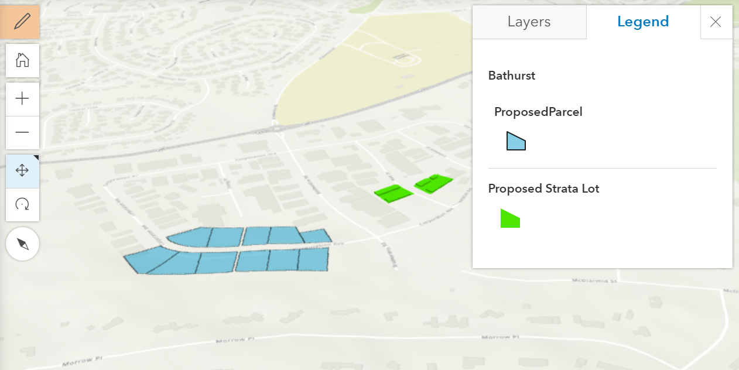
Land parcel and property – Proposed Cadastre
Notes:
An example of torrens title (blue) and strata title (green) applications visualised as a result of digitisation process.

Slide 20
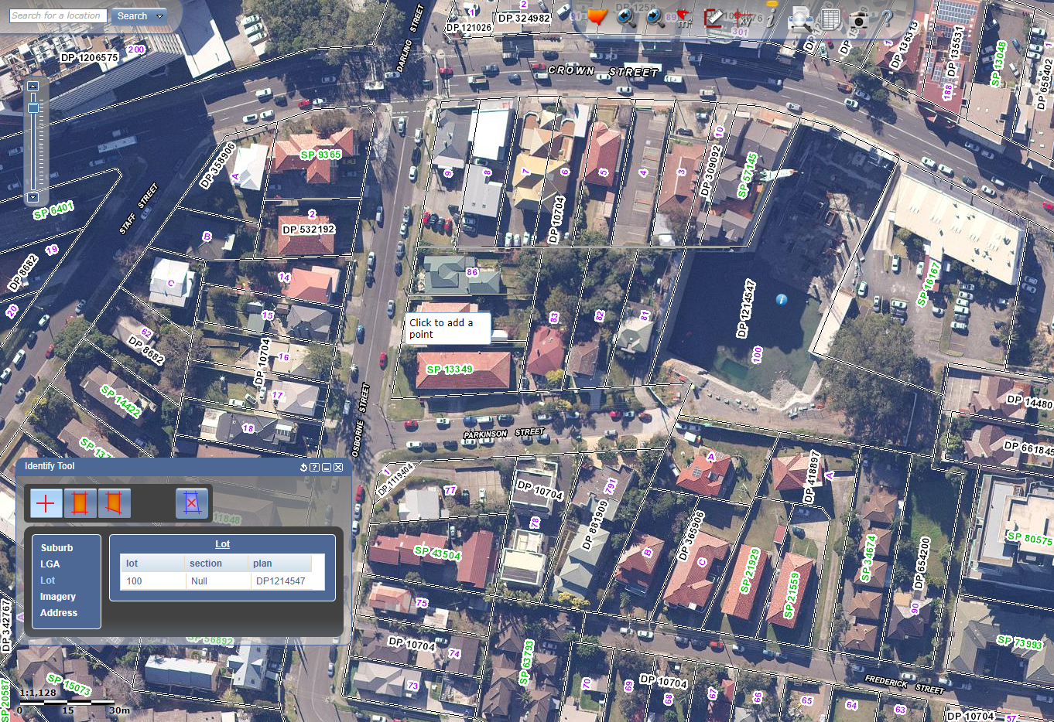
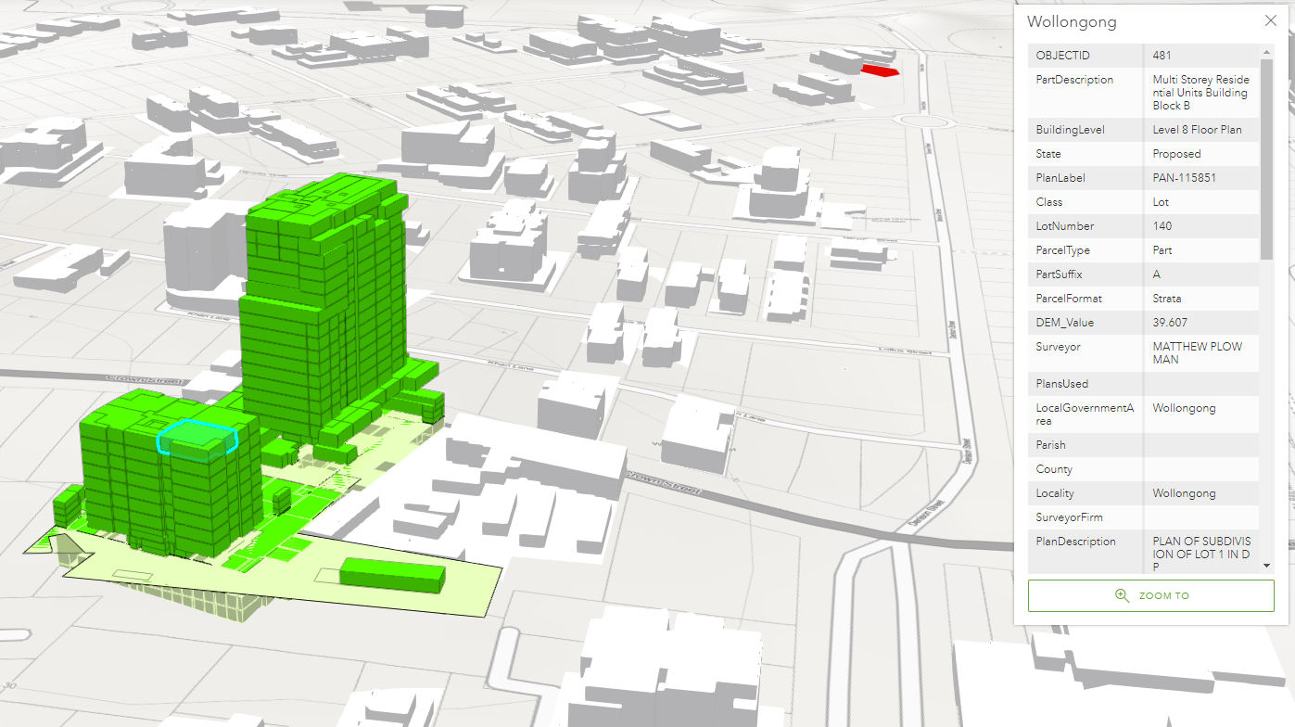
Land parcel and property – 2D to 3D & 4D
SIX Maps – 2D view
3D strata: registered (white), DA approved (green)

Slide 21
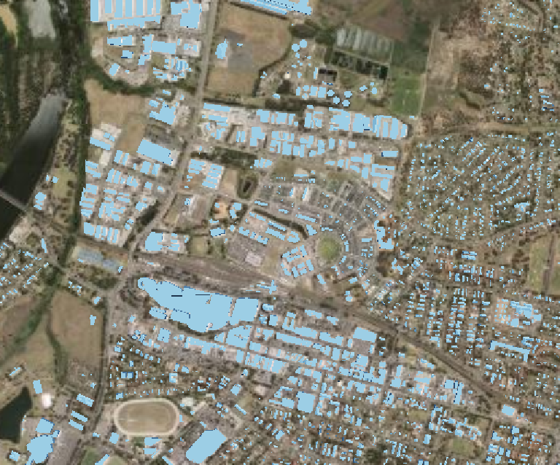
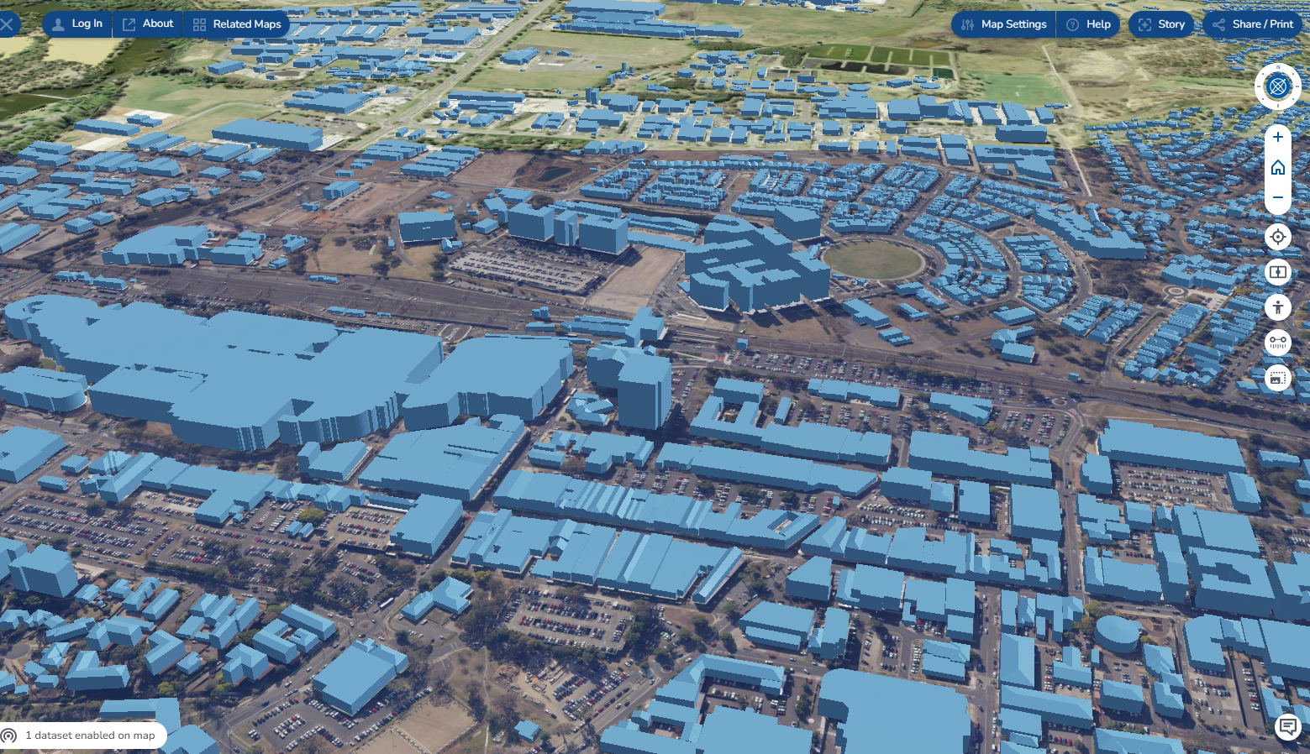
Buildings and settlements
Notes:
Geoscape building footprints dataset – Spatial Services have purchased a whole of Government licence to utilise the dataset, with Spatial services value adding to visualise in 3D. We’ve had lots of requests for access from across Government and it has been used for both flood modelling and response activities.

Slide 22
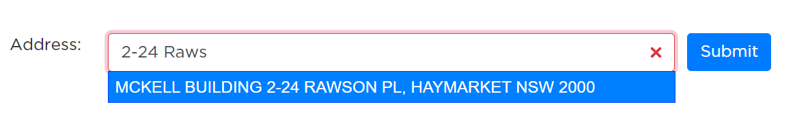
Whole of government address management
NSW Point
Address validation service
Embedded into 163 NSW Government forms
Over 166 million API requests in 2022
Supporting key services such as vouchers, disaster relief grants and online licensing
Proposed address data
Off the back of ePlanning and Digital Survey Plan reforms we are investigating how we can improve proposed property address workflows
|
Notes:
Only potential addition is roll-out of NSW Point to Local Government

Slide 23
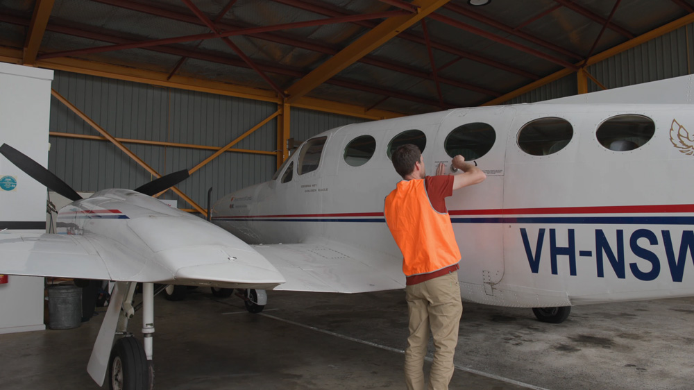

Slide 24
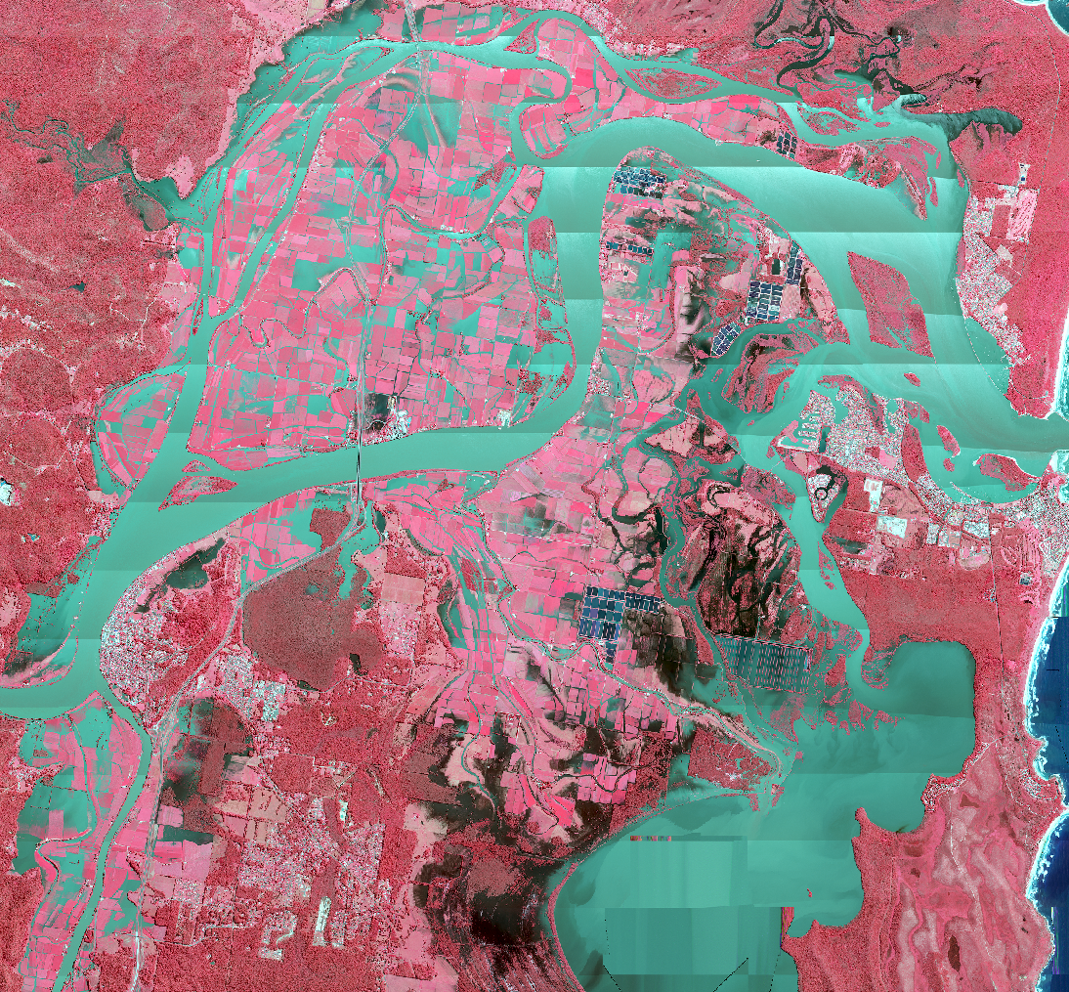
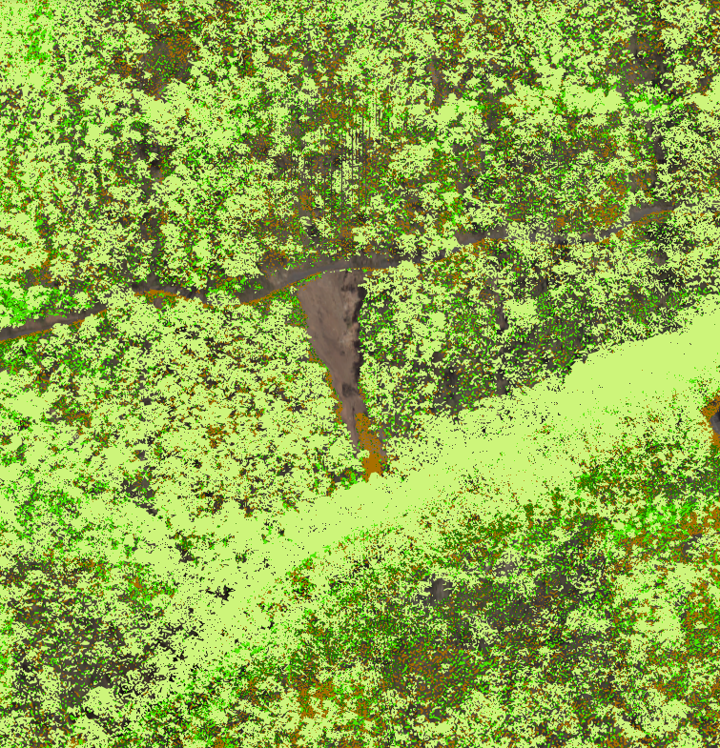
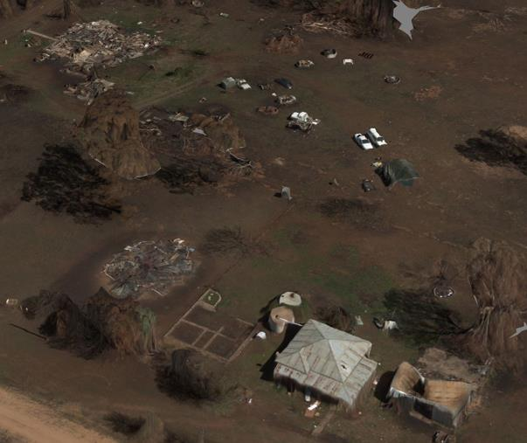
Environmental Spatial Programs
Imagery
LiDAR
3D Models

Slide 25
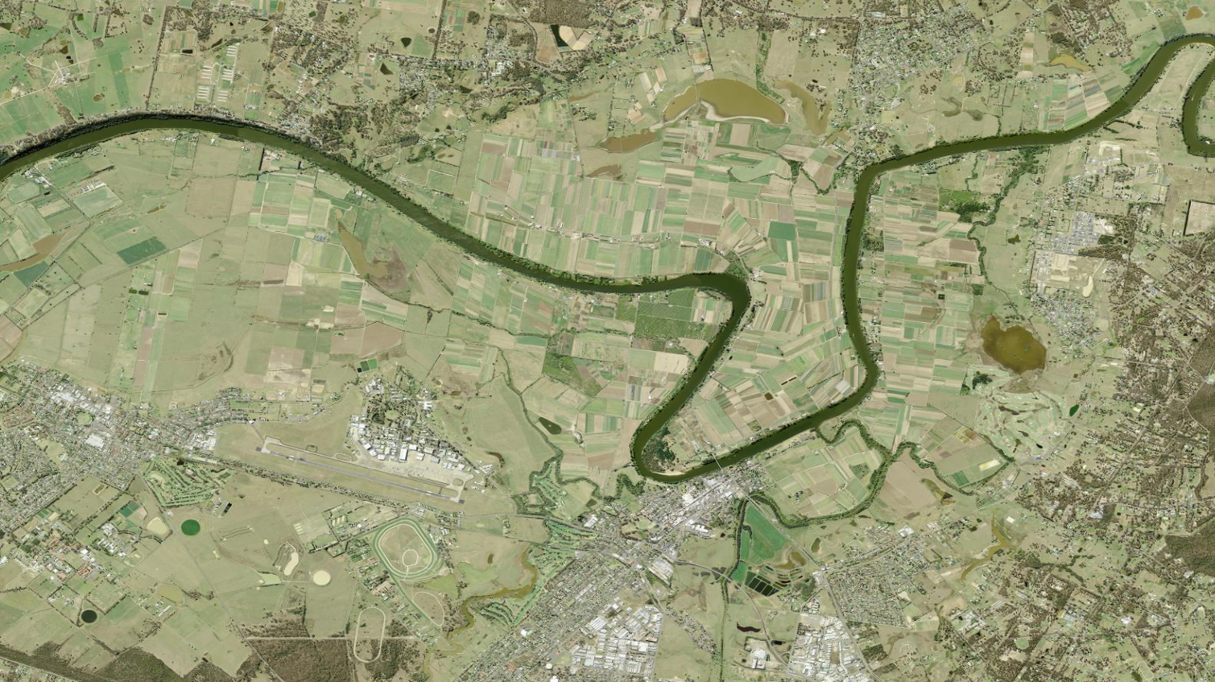
Windsor/Richmond 2012

Slide 26

Windsor/Richmond March 2022

Slide 27
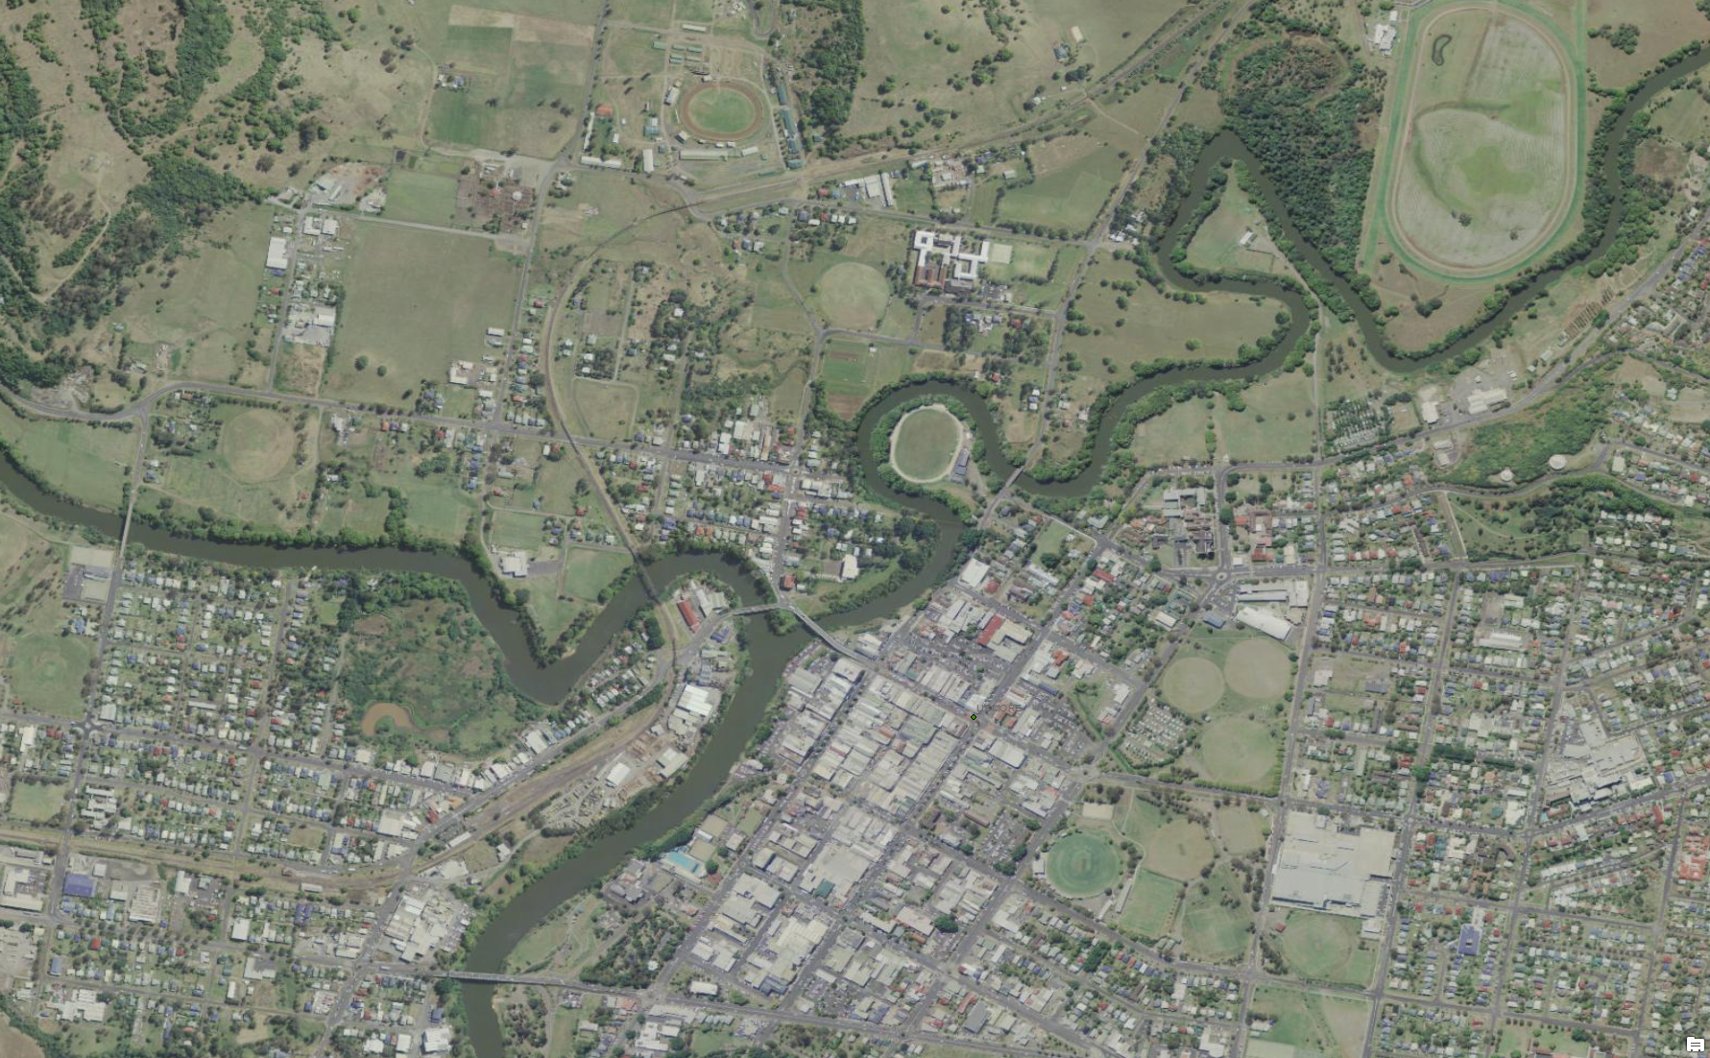
Lismore 2012

Slide 28
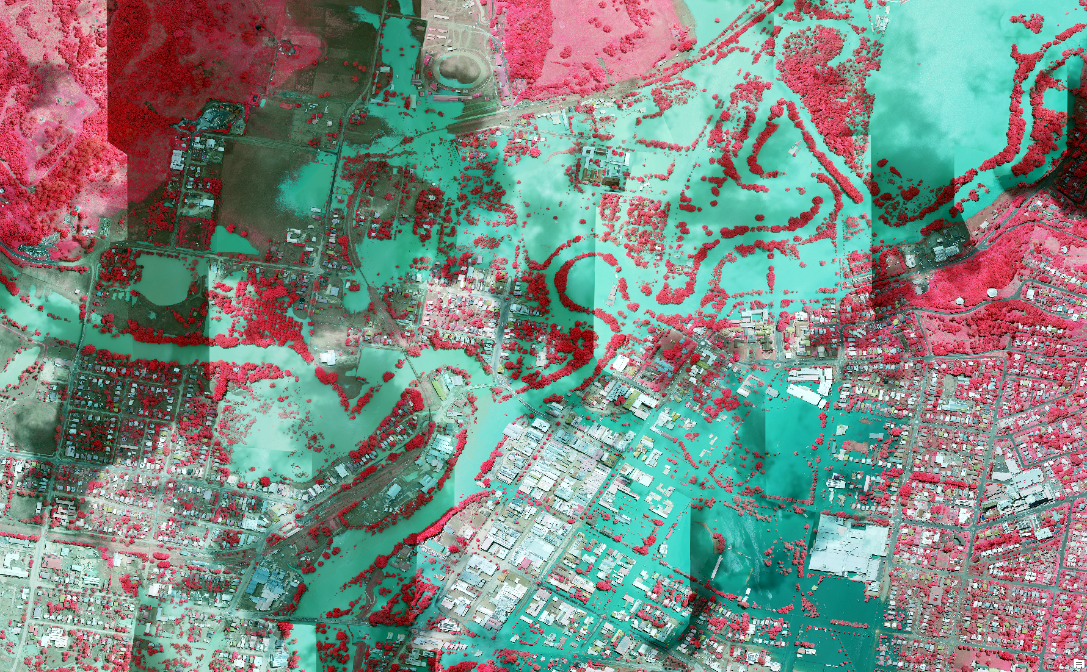
Lismore March 2022

Slide 29
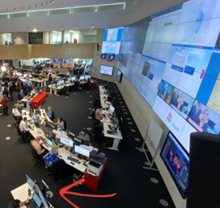

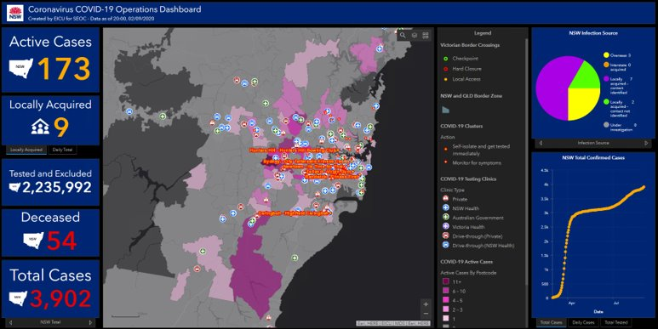
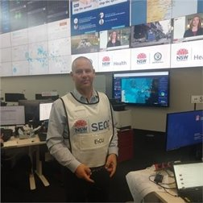

Slide 30





Emergency Information Coordination Unit
The primary liaison point during an emergency – requiring interfacing with all Spatial Services business units. Also the key conduit for providing data from within external sources, such as Copernicus Flood Extents via Geoscience Australia and the European Union.
Produce the Emergency Services Spatial Information Library (ESSIL). Curating ~11,000 datasets from 200 source agencies into 350 seamless layers – critical for prevention, preparedness, response, and recovery.
Provide analysis and products during emergencies and major events, such as impact assessments, live dashboards, web services and feeds, in addition to spatial analysis and cartographic support.
SIMS Online: Collaborative ESRI web application with ESSIL as well as a variety of web feeds from other agencies, which can be utilised as a Common Operating Picture for situational awareness. Used extensively by other EM agencies such as the Telecommunications Functional Area.

Slide 31
Use of AI/ML for flood extent mapping
Collaborating with Charles Sturt University to investigate the use of artificial intelligence and machine learning (AI/ML) for spatial data capture, object detection and maintenance.
Successful outcomes from student-led initiatives last year on flood extent detection and natural language processing. We continue to support students with technical expertise.
This work includes identifying target datasets and some high-value AI/ML projects to support building footprints and road identification.
Operationalised the capability and are using AI/ML to generate flood extents for imagery captured in 2021 and 2022. We are now testing this capability on imagery captured by third party and commercial providers.

Slide 32
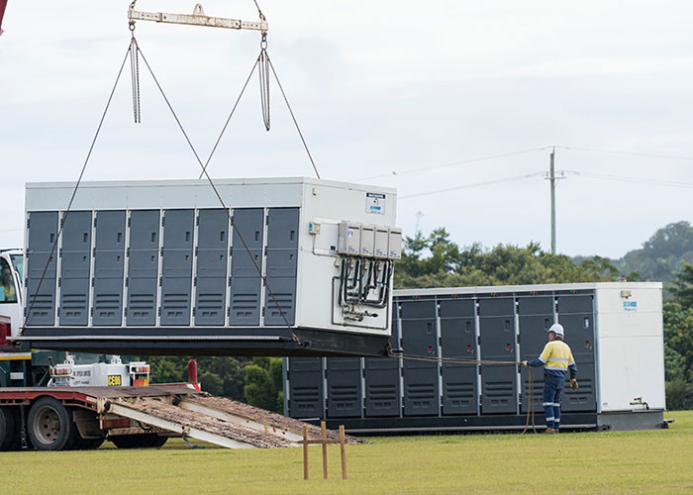
Use of the elevation model and the cadastre to identify safe sites for storage and temporary accommodation
The process of adding slope and aspect data to the cadastre involves bringing together our state-wide Digital Elevation Model (DEM) data and the lot layer of the Cadastre.
Part of the product suite for the state-wide DEM is a slope and aspect dataset. When we bring the three datasets (slope, aspect, cadastre) together we calculate the average, minimum and maximum slope for each land parcel. We also calculate the average aspect (slope direction) of each parcel. These attributes are then added to the existing attribution for each cadastral lot to create the final product.
The data was supplied to DPE who was then easily able to determine, based on the attribution, the most suitable sites available for temporary housing.

Slide 33

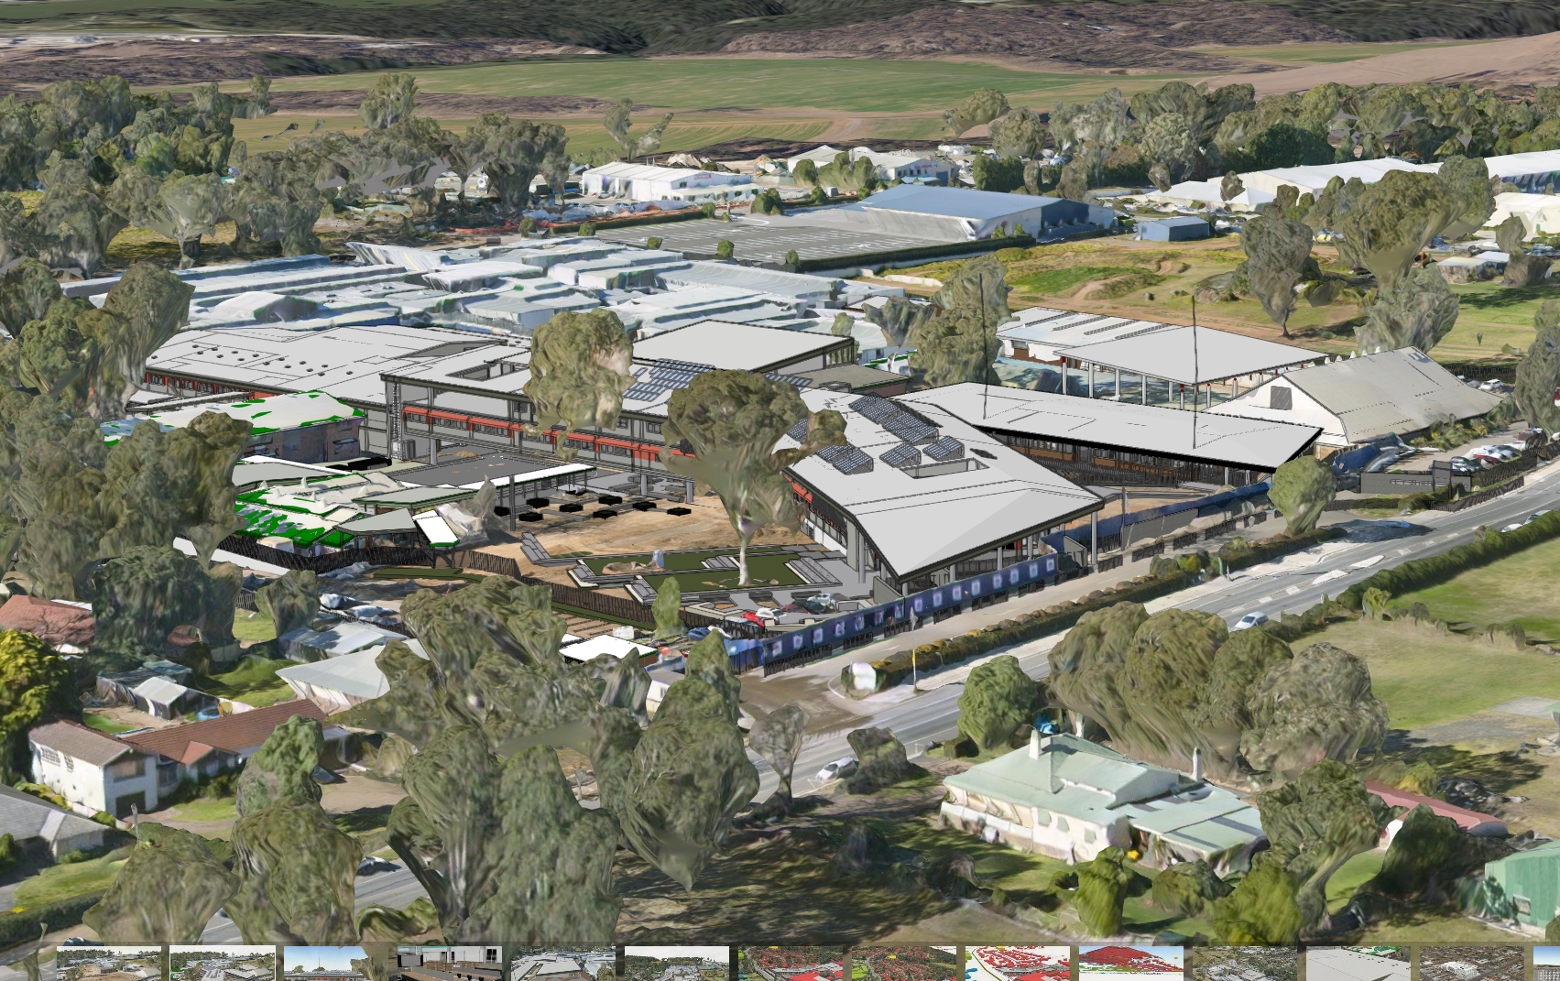
Communities, industry and government all benefit from the NSW SDT
Case Study: School Infrastructure NSW (SINSW)
Problem: | SINSW is responsible for the delivery and management of a portfolio of 2,200+ schools SINSW developed over 80 business cases in 2020 alone Compared with construction, the business case phase can take up to twice as long to complete
Opportunity: | Combined with other technologies, the Live NSW Spatial Digital Twin (SDT) program will support the digitisation and automation of the business case process SINSW estimates that this will lead to a 45% reduction in time to deliver a strategic business case
Benefit: | SINSW estimates savings of $202m over 10 years, in avoided strategic business case costs This benefit will be generated by the SDT and realised by SINSW
Extract from NSW Spatial Digital Twin Program Final Business Case
Prepared by DCS Spatial Services and Ernst & Young (2021) Approved by ERC October 2021

Slide 34
School Infrastructure NSW: opportunities
There are considerable opportunities to improve efficiency and effectiveness throughout the infrastructure lifecycle.
These include improved due diligence as part of Strategy and Needs Analysis to more efficient master planning and cost planning and digital twins for maintenance and management of school assets.
Initial focus has been on the efficiency of due diligence. Completing early data-driven due diligence enables School Infrastructure NSW to more efficiently understand risks and opportunities.
Planning and decision making
Delivery and acquisition
Sustain assets
Strategy and needs analysis
Infrastructure
Lifecycle

Slide 35
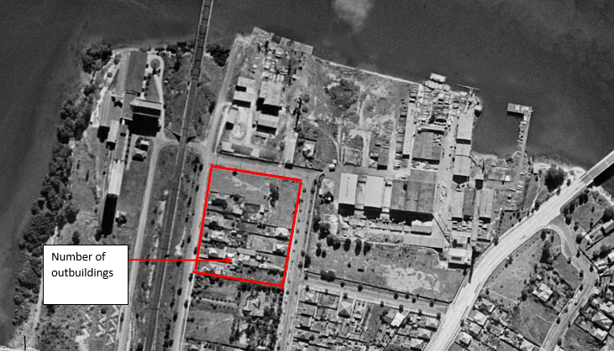
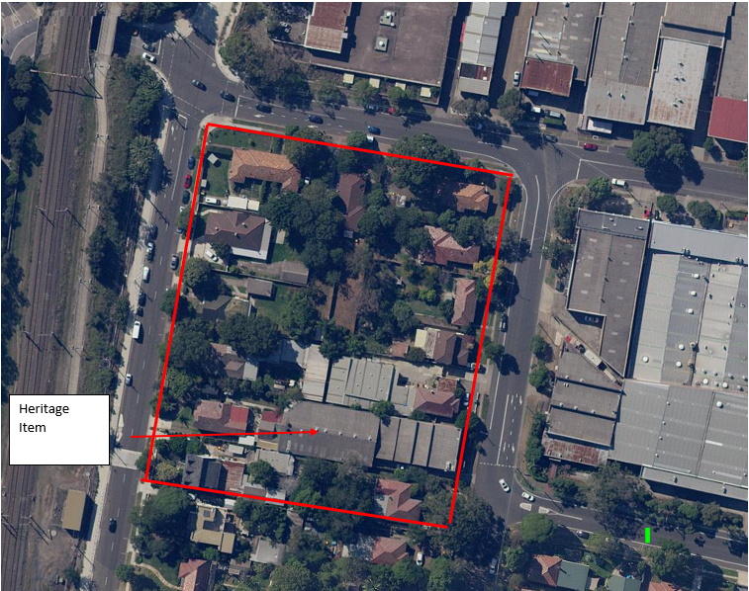
Progress to date: due diligence pilot
A standardised approach to due diligence was developed and piloted on 473 sites in 4 weeks
The productivity benefits and avoided costs in this pilot alone are an estimated $4.4m
Current plans require due diligence for a further ~1200 school sites
Reduction in the number of procurements and consultants required
Clear, well-informed procurement scopes to reduce scope creep
Project information identified, developed and converted to asset management information to support a complete project process
Supporting the development of project documentation and implementation of modern methods of construction
Focusing our consultants on the issues/risks rather than ‘the doing’
1943
Present

Slide 36
NSW SDT – key enabler to efficiently deliver NSW’s infrastructure portfolio
Education
$9.2 billion
Health
$11.9 billion
Transport
$76.7 billion
Other
$14.9 billion
Initiation
$90.8m savings over four years*
Further benefits realisation available across entire infrastructure portfolio
Design
Procurement
Further benefits realisation available across other stages
Construction
Maintenance
A 1% efficiency saving across infrastructure portfolio = $1.1b savings potential
*Real discounted $ extracted from NSW Spatial Digital Twin Program Cost Benefit Analysis
Prepared by Ernst & Young (2021) Approved by ERC October 2021

Slide 37
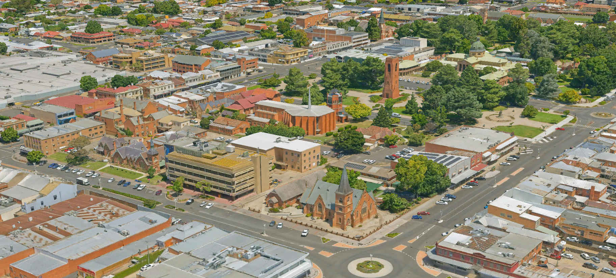
Questions?

