Slide 1
Bush Fire Planning Update
EDAP 21st Annual Conference – Nyngan 2023
Presented by Erika Dawson

Slide 2
Introduction
Changes to the NCC regarding Class 9 buildings defined as ‘special fire protection purpose’ (SFPP) – Deemed to Satisfy (DTS) provisions only.
Addendum to Planning for Bush Fire Protection (PBP):
To reflect NCC changes
House keeping reference changes

Slide 3
NCC Class 9 SFPP Changes

Slide 4
NCC Class 9 SFPP Requirements
NCC 2019 | NCC 2022
DTS Applies to Class 9 SFPP Building located within a designated Bush Fire Prone Area (BFPA) | DTS Applies to Class 9 SFPP Building located within a designated BFPA only if it is BAL-12.5 or less
NSW variation only | Mixture of NSW Variations & Standard NCC provisions
Requirements: Compliance with AS3959 (as amended by PBP), Or AS3959 as amended by a development consent Or AS3959 as amended by a Bush Fire Safety Authority. | Requirements detailed in following slides

Slide 5
NCC 2022 Class 9 SFPP Requirements
Application of DTS (NSW G5D2)
DTS provisions ONLY apply if the development is located in an area of BAL-12.5 or less (BAL determined in accordance with PBP).
If located in a higher BAL area → Performance Solution.
Location in ≤BAL-12.5 should be the norm as determined through DA.
Protection – Class 9 buildings used as SFPP (NSW G5D4) must comply with:
Class 9 building - Specification 43 as amended by PBP; or
Appurtenant class 10a buildings/decks – PBP or S43C13; or
The above as modified by a BFSA issued as part of a development consent.

Slide 6
Specification 43
Separation from classified vegetation (NSW S43C2)
No provisions as PBP requires Asset Protection Zones as part of the DA.
Separation between buildings (S43C3)
12m separation from any other building
Not required if:
external walls have FRL 60/60/60 and openings BAL-19 or
walls and roof use materials/system tested to AS1530.8.1 to 10kW/m²
Separation from allotment boundaries and carparking areas (S43C4)
10m separation to lot boundary or opening carparking areas/spots
Not required if:
external walls have FRL 60/60/60 and openings BAL-19 or
walls and roof use materials/system tested to AS1530.8.1 to 10kW/m²

Slide 7
Specification 43 (cont.)
Separation from hazards (S43C5)
10m separation from potential hazards on the site such as liquefied petroleum gas bottles, fuel storage, storage of combustible materials, waste bins, vehicles, machinery, and the like, or
Not required if:
external walls have FRL 60/60/60 and openings BAL-19 or
walls and roof use materials/system tested to AS1530.8.1 to 10kW/m²
Non-combustible path around building (S43C6)
1.5m non combustible path provided around the perimeter of and directly adjacent to the building.
Access pathways (S43C7)
That lead to road/open space need to be 1m min clear width, readily identifiable & even surface
Note, requirements of Part D4 override where inconsistencies are present.

Slide 8
Specification 43 (cont.)
Exposed external areas (S43C8)
Any external area required (i.e. refuge area) to not be exposed to radiant heat flux of ≤ 1kW/m²
Internal tenability (S43C9)
Air handling system to maintain internal air temp at ≤25°C & fully recycled for ≥ 4 hours to avoid smoke intrusion (applies to each building compartment)
If air handling system fails, the building envelope must be designed to maintain internal air temps ≤39°C & internal surface temps ≤60°C
Building envelope (S43C10)
Building envelope constructed to minimum AS3959 BAL-19

Slide 9
Specification 43 (cont.)
Supply of water for fire-fighting purposes (NSW S43C11)
Either:
A fire hydrant system complying with E1D2, or
Static Water Supply consisting of tanks, swimming pools, dams or the like, or a combination of these, together with suitable pumps, hoses and fittings, determined in consultation with the relevant fire brigade that:
is capable of providing the required flow rate for a period of not less than 4 hours; or
has a volume of 10 000 litres for each occupied building

Slide 10
Specification 43 (cont.)
Emergency power supply (S43C12)
Must be provided to support, for ≥4 hours before and ≥2 hours after the passing of the fire front, the ongoing operation of—
air handling systems; and
any pumps for fire-fighting; and
any emergency lighting and exit signs; and
any other emergency equipment listed in C3D14(6) and required to be provided.
Manual control for emergency back-up power supply must be provided to facilitate manual intervention where the power supply fails or runs out.

Slide 11
Specification 43 (cont.)
Signage (S43C13)
Signage must be provided to warn building occupants against storing combustible materials under or adjacent to the building
Vehicular access
Vehicular access to the building must be provided in accordance C3D5(2), as if the building were a large isolated building for the purposes of C3D4.

Slide 12
PBP & Addendum

Slide 13
PBP Addendum
Addendum effective from 1 May 2023 (with adoption of NCC 2022)
Updates references to changed SEPPs, legislation, Australian Standards, etc.
Updates requirements for SFPP development to provide consistency with NCC requirements.
The addendum + existing PBP provisions for SFPP (chapter 6) are now applicable.

Slide 14
PBP Changes for SFPP
Asset Protection Zones
No change - determined by Table A1.12.1 of PBP and in accordance with other PBP requirements.
Landscaping
No change to existing PBP requirements
Construction Standards
Addendum applies – changed to minimum AS3959 BAL-19 and section 7.5 of PBP.

Slide 15
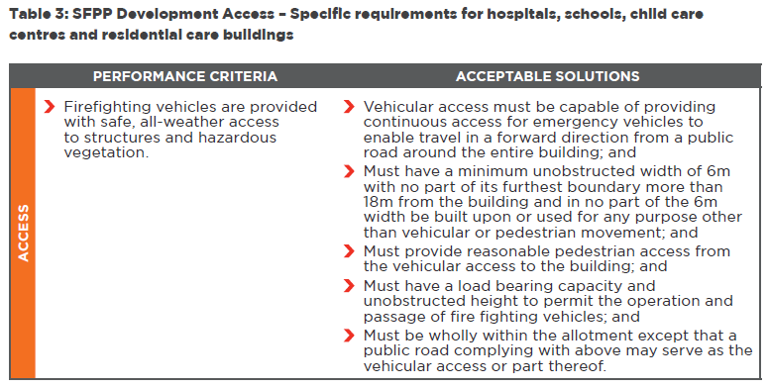
PBP Changes for SFPP (cont.)
Access
Appears new Addendum provisions applied in addition to existing PBP access provisions to pick up new NCC requirement for large isolated building access:

Slide 16
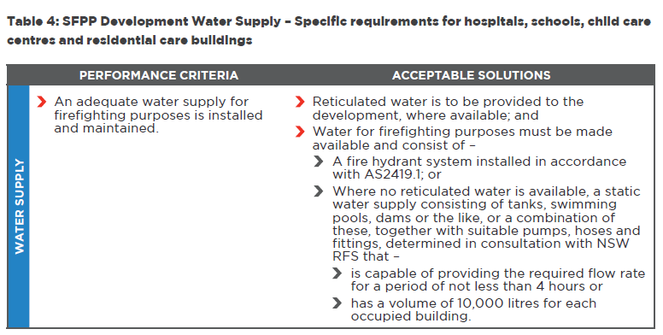
PBP Changes for SFPP (cont.)
Water Supply
Appears new Addendum provisions applied in addition to existing PBP water supply requirements to pick up NCC requirements:

Slide 17
PBP Changes for SFPP (cont.)
Electricity Services
No change from PBP
Gas Services
No change from PBP
Emergency management planning
No change from PBP

Slide 18
Thank You & Questions
Contact
www.integratedconsulting.com.au
erika@integratedconsulting.com.au

